Slide 1
Multidimensional Scaling
(MDS)

Slide 2
MDS
Purpose is to identify the key elements underlying the data
Similar to factor analysis in that it groups the variables and not the people

Slide 3
MDS
Groups variables in 3D space
Gives you:
Number of dimensions to data
Importance of those dimensions
Visual picture of relationship between dimensions

Slide 4
MDS
Perceptual mapping – creating a picture of how the variables relate to each other in space.

Slide 5
Example
We are interested in understanding consumers’ perceptions of six candy bars on the market. Instead of trying to gather information about consumers’ evaluation of the candy bars on a number of attributes, the researcher will instead gather only perceptions of overall similarities or dissimilarities. The data are typically gathered by having respondents give simple global responses to statements such as these:
- Rate the similarity of products A and B on a 10-point scale
- Product A is more similar to B than to C
- I like product A better than product C

Slide 6
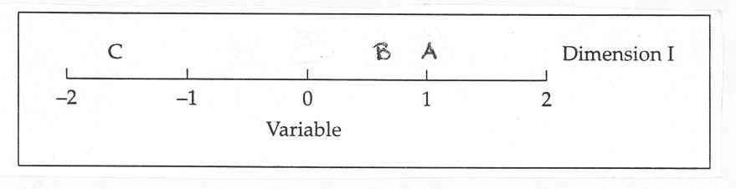
1 dimensional picture

Slide 7
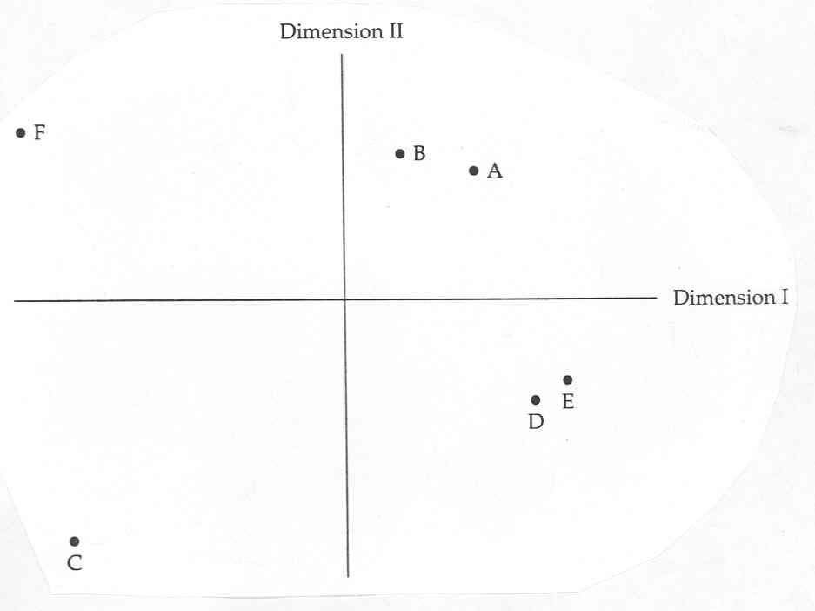
2 dimensional picture

Slide 8
Dimensions?
But we aren’t really sure what those two dimensions are…so we have to interpret the relationship between ratings to figure that out.

Slide 9
MDS
So, this design is exploratory statistics to indentify the dimensions in behavior
AND
The comparison of objects on these dimensions

Slide 10
MDS
Simpler:
A pretty picture of the similarities in the data.

Slide 11
Data Issues
If your data are dissimilarity data, all dissimilarities should be quantitative and should be measured in the same metric.
In English, this means that if you are taking product ratings, you should use the same scale for every question and it should be close ended questions.

Slide 12
Data Issues
If your data are multivariate data, variables can be quantitative, binary, or count data.
Scaling of variables is an important issue--differences in scaling may affect your solution.
If your variables have large differences in scaling (for example, one variable is measured in dollars and the other variable is measured in years), consider standardizing them (this process can be done automatically by the Multidimensional Scaling procedure).

Slide 13
Assumptions
Not that many! Yay!
Make sure you select the option that corresponds to the type of data you have in SPSS.

Slide 14
Distancing
In SPSS, you can pick a bunch of different distancing formulas:
Euclidean distance. (default for interval data)
Squared Euclidean distance.
Chebychev.
Block.
Minkowski.
Customized.

Slide 15
Distancing
For count data (frequency counts):
Chi-square measure. (default)
Phi-square measure.
Binary Data:
Euclidean distance.
Squared Euclidean distance.
Size difference
Pattern difference
Variance
Lance and Willliams

Slide 16
Output
How do I tell if my model is a good model?
RSQ = R2 = amount of variance accounted for by the number of dimensions you picked and how well they classify
How do I tell what the dimensions are?
Look at the picture!

Slide 17
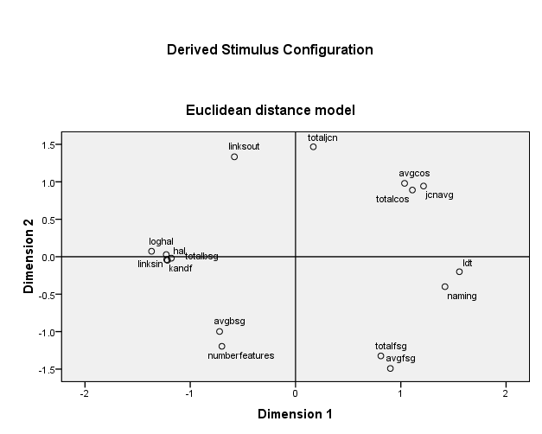

Slide 18
Dimensions
Everything above dimension 2 line is mostly semantic / below mostly associative
Dimension two is the distinction between assoc/semantic
Everything on the left side of dimension 1 is mostly frequency counts / right side mostly averages
Dimension one is distinction between counts and averages

Slide 19
Example
42 traits (personality characteristics) were measured on 1-7 scales
Didn’t standardize since they are all on the same scale
Scaled with 2 dimensions

Slide 20
Output
R2 = .93
So two dimensions is pretty good fit

Slide 21
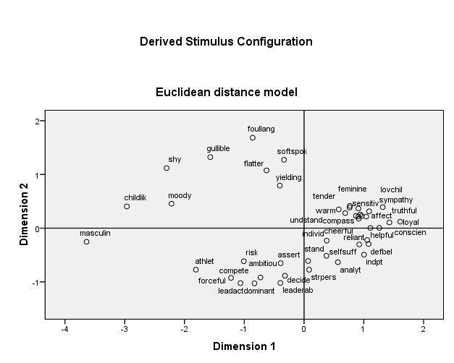

Slide 22
Interpretation
So what would dimension 1 be?
What would dimension 2 be?

